Slide 1
SUCCESSFUL ATTRIBUTES FOR CAREER OF STUDENTS USING AI TECHNOLOGY Name: P.Vazhmuni Reg.No: 422323622022 Guide By: Prof.R.MALARVANNAN HOD,M.C.A DEPARTMENT

Slide 2
Company Profile – Inmakes Infotech Pvt. Ltd.
Established in 2020 and headquartered in Coimbatore, India.
Specializes in software, web, mobile app development, and AI solutions.
Offers digital transformation services across education and enterprise sectors.
Focuses on innovation, integrity, and customer success.
Empowers students and professionals through advanced technology.

Slide 3
Abstract
Predict student success using machine learning.
Analyze grades, attendance, and personal attributes.
Identify at-risk students to support timely intervention.
Evaluate models: Naïve Bayes, Decision Tree, KNN, SVM, Random Forest.

Slide 4
Introduction
Education Sector Trend
Institutions now use ML to analyze student data and predict outcomes
Vision
Promote data-driven decisions in education through predictive analytics for personalized learning.
🎯 Aim
Build a predictive model to assess student performance using academic and behavioral data.
✅ Objectives
Apply ML models (Naïve Bayes, Decision Tree, KNN, SVM, MLP).
Use DL models (ANN, CNN) to classify successful vs. at-risk students.

Slide 5
Problem Statement
Many students struggle academically, leading to dropouts and delays.
Traditional methods (exams, assignments, observation) are slow and ineffective.
At-risk students are often identified too late
A data-driven method to predict student success early.
Enables timely support and reduces dropouts.

Slide 6
Existing system
Association rule learning helps identify interesting relationships between attributes in the dataset.
This can be useful for uncovering patterns, such as which behaviors or characteristics tend to correlate with student success.
Clustering groups students into clusters based on similar attributes. For example, students who share similar study habits, exam scores, or attendance records could be grouped together.

Slide 7
Disadvantages
Not Efficient for handling large volume of data.
Incorrect Classification Results.
Poor Memory
This creates the data, making it non-representative of the general student population.
As a result, the findings may not generalize well to other groups or academic institutions.

Slide 8
Proposed system
Uses both Machine Learning (ML) and Deep Learning (DL) algorithms.
Predicts student success attributes with improved accuracy and reliability.
Enhances overall classification performance.
Uses student grade data for faster and efficient predictions.
Enables comparison between ML and DL models for optimal results

Slide 9
Literature survey
Uma et al. (2023) used seven supervised algorithms (NB, DT, KNN, SVM, MLP, etc.) and ensembles to predict student success, achieving about 86.3% accuracytheijire.comtheijire.com.
An ensemble (Naïve Bayes + Bayesian Network + SVM) reached 84.06% accuracy with 93.18% sensitivity (78.48% specificity) in a student success studytheijire.com.
Common metrics in literature include accuracy, precision, recall, F1-score, sensitivity, and specificity for evaluating classification models.

Slide 10
System Specification
Hardware Requirements
Processor: Intel Core i3 or higher
RAM: 4GB or more
Hard Disk: 200GB minimum
Keyboard & Mouse: Standard
Software Requirements
Operating System: Windows 7 or later
Programming Language: Python
Libraries: NumPy, Pandas, Matplotlib, Scikit-learn, TensorFlow (for deep Learning)
IDE: Pycharm(Anaconda Navigator - Spyder)

Slide 11
Project Description
Data Preprocessing
Clean the collected dataset.
Handle missing or inconsistent values.
Normalize and structure the data for model input.
Feature Engineering:
Generate important features like GPA trends, skill rating, domain expertise, psychometric scores, and participation in events (technical/cultural).

Slide 12
Methodology
Data Collection
Gather student data: academic records, attendance, demographics, extracurriculars, etc.
Data Preprocessing
Handle missing or inconsistent data.
Normalize or standardize numerical values.

Slide 13
Model Selection
Machine Learning models: Naïve Bayes, Decision Tree, KNN, SVM, Random Forest.
Model Training
Split data into training and test sets.

Slide 14
System Design
Interactive UI using IPython Notebook or Web App
Features:Login authentication,Student data input forms,Prediction result display dashboard
Python-based ML engine for:
Training machine learning and deep learning models
Generating predictions
Serving results to front-end/dashboard

Slide 15
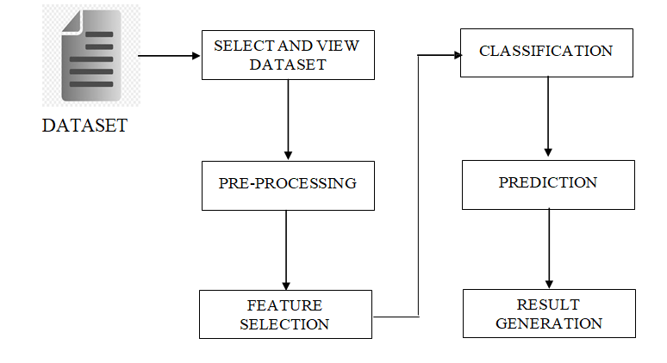
Architecture System

Slide 16
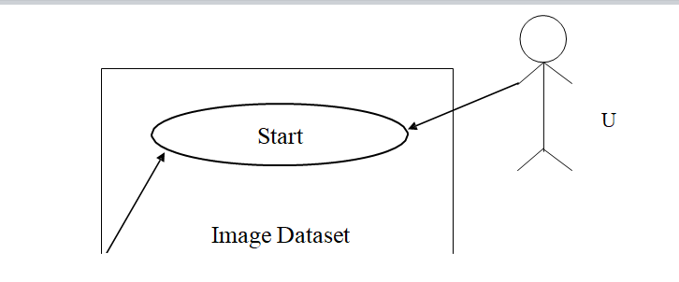
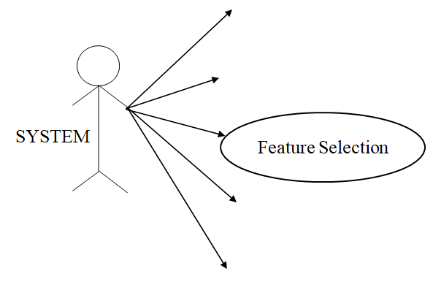
Use Case

Slide 17
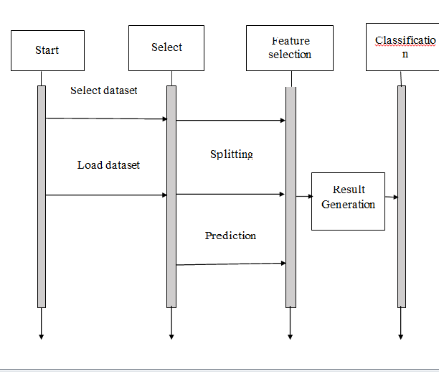
Sequence

Slide 18
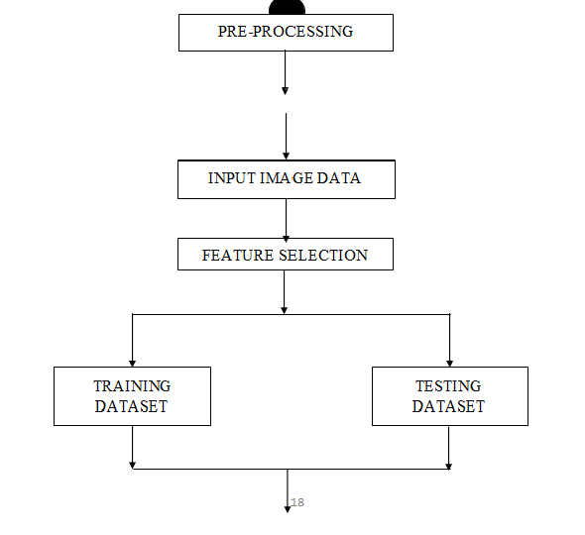
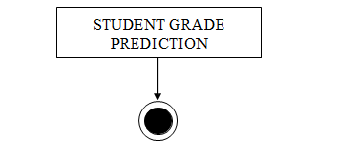
Activity

Slide 19
Testing
Unit Testing: Tested individual modules like data preprocessing and model training.
Integration Testing: Verified interaction between components (UI, ML model, database).
Functional Testing: Ensured prediction and result generation functions as expected.
System Testing: Checked overall system behavior in real-time environments.
Performance & Usability Testing: Assessed speed, accuracy, and user-friendliness.
Regression Testing: Ensured updates didn’t affect existing functionality.

Slide 20
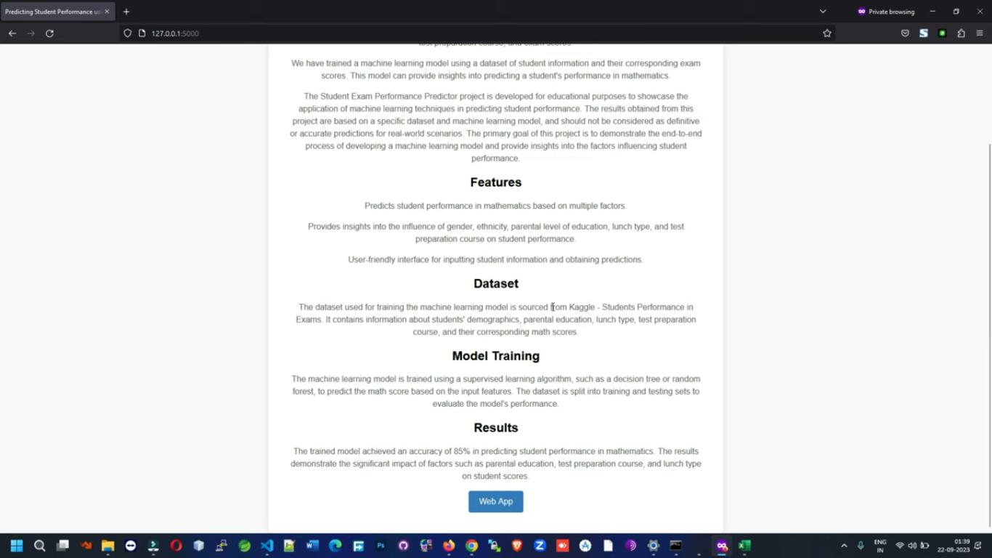
SCREEN SHOTS

Slide 21
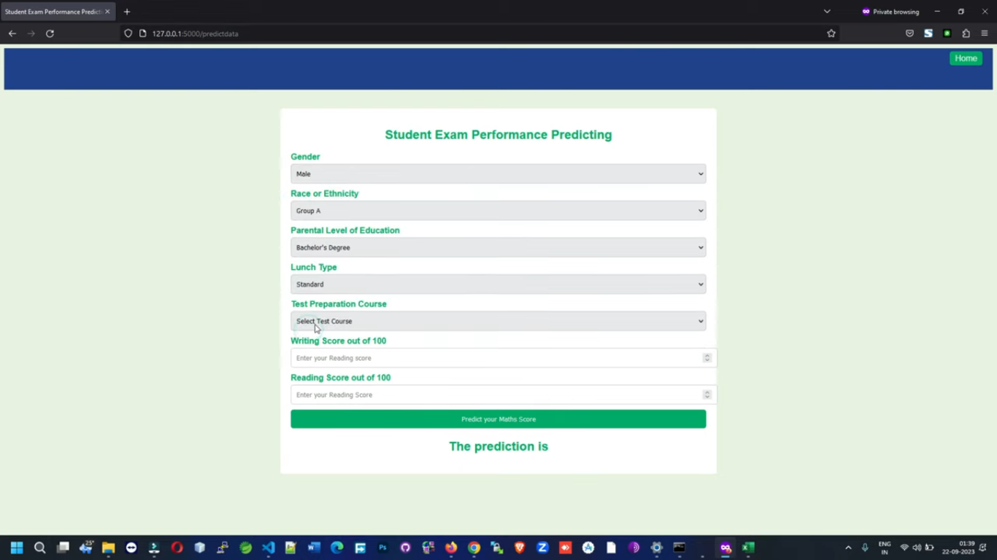

Slide 22
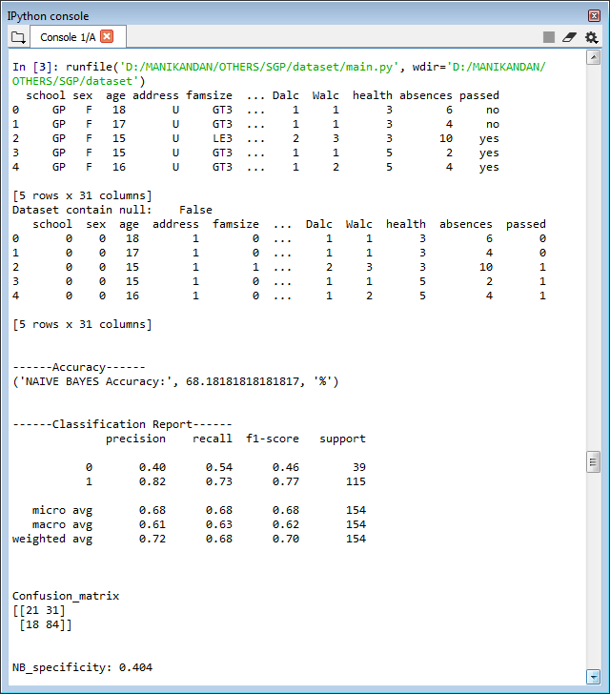

Slide 23
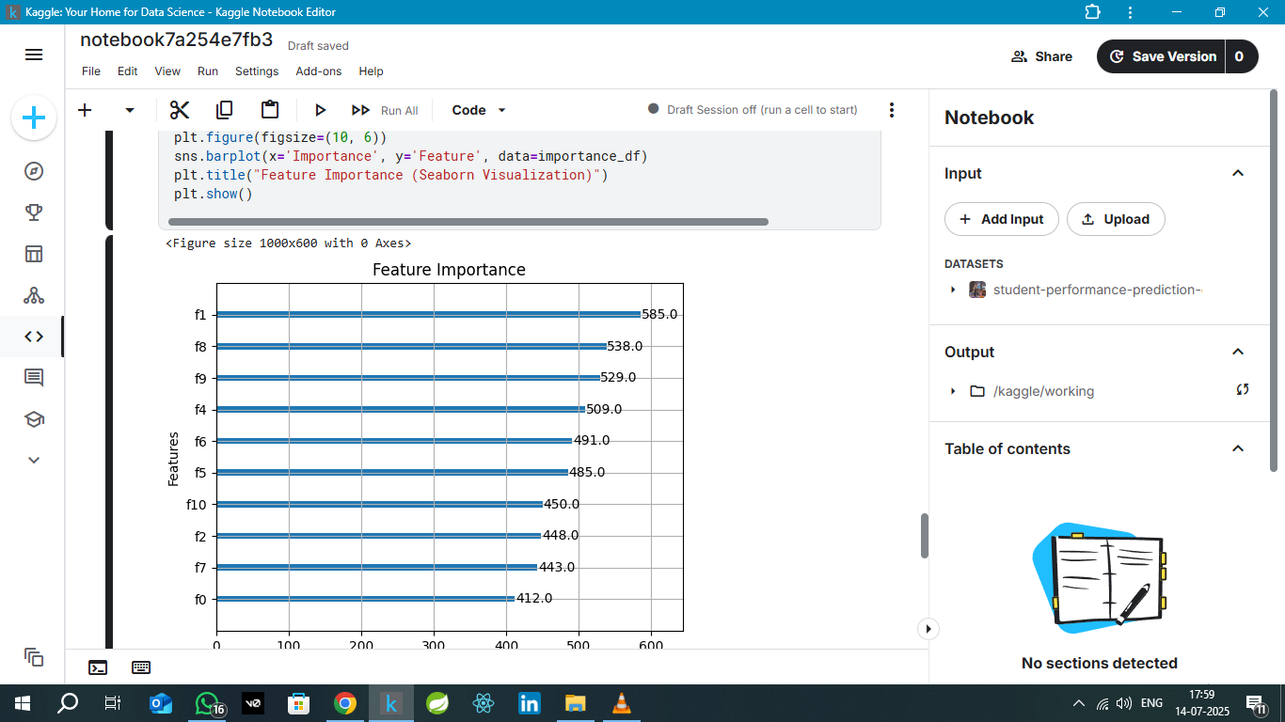

Slide 24
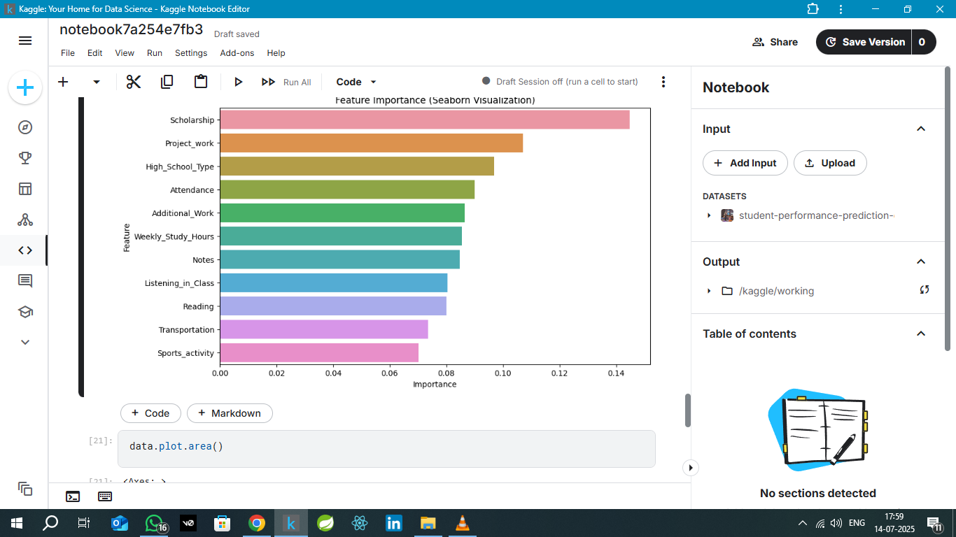

Slide 25
Conclusion
The project successfully predicts student success using machine learning techniques.
Machine learning models like Decision Tree
Random Forest, and SVM demonstrated
high accuracy in predicting outcomes.
This project contributes to enhancing educational
quality and student success rates.

Slide 26
Future Enhancement
Fine-tune predictive models using larger and more diverse student datasets.
Integrate sentiment analysis from surveys, feedback, or online behavior.
Conduct interviews with misclassified students to improve model accuracy.
Implement real-time integration with LMS and academic portals.
Design targeted academic interventions based on predictive insights.

Slide 27
Result
Successfully predicted student career outcomes such as placement, higher studies, and entrepreneurship.
Implemented machine learning and deep learning algorithms like Naive Bayes, Decision Tree, KNN, SVM, MLP, and CNN.
Achieved high accuracy using key performance metrics: Accuracy, Precision, Recall, F1-score, Specificity, and Sensitivity.

Slide 28
Reference
Uma Maheswari, P., & Kavitha, V. (2023). Predicting Student Success Using Machine Learning Algorithms. International Journal of Innovative Technology and Exploring Engineering.
Yadav, S. K., & Pal, S. (2012). Data Mining: A Prediction of Performer or Underperformer Using Classification. International Journal of Computer Science and Information Technologies.
Zhang, J., & Li, H. (2018). Prediction of Student Academic Performance Based on Data Mining Techniques. International Journal of Computer Applications.
Scikit-learn Documentation. https://scikit-learn.org
TensorFlow Documentation. https://www.tensorflow.org

Slide 29
Thank You!

